Slide 1


Firstly the user login the systems.
The password is defined under service. It is coming from SQL Server.

Slide 2
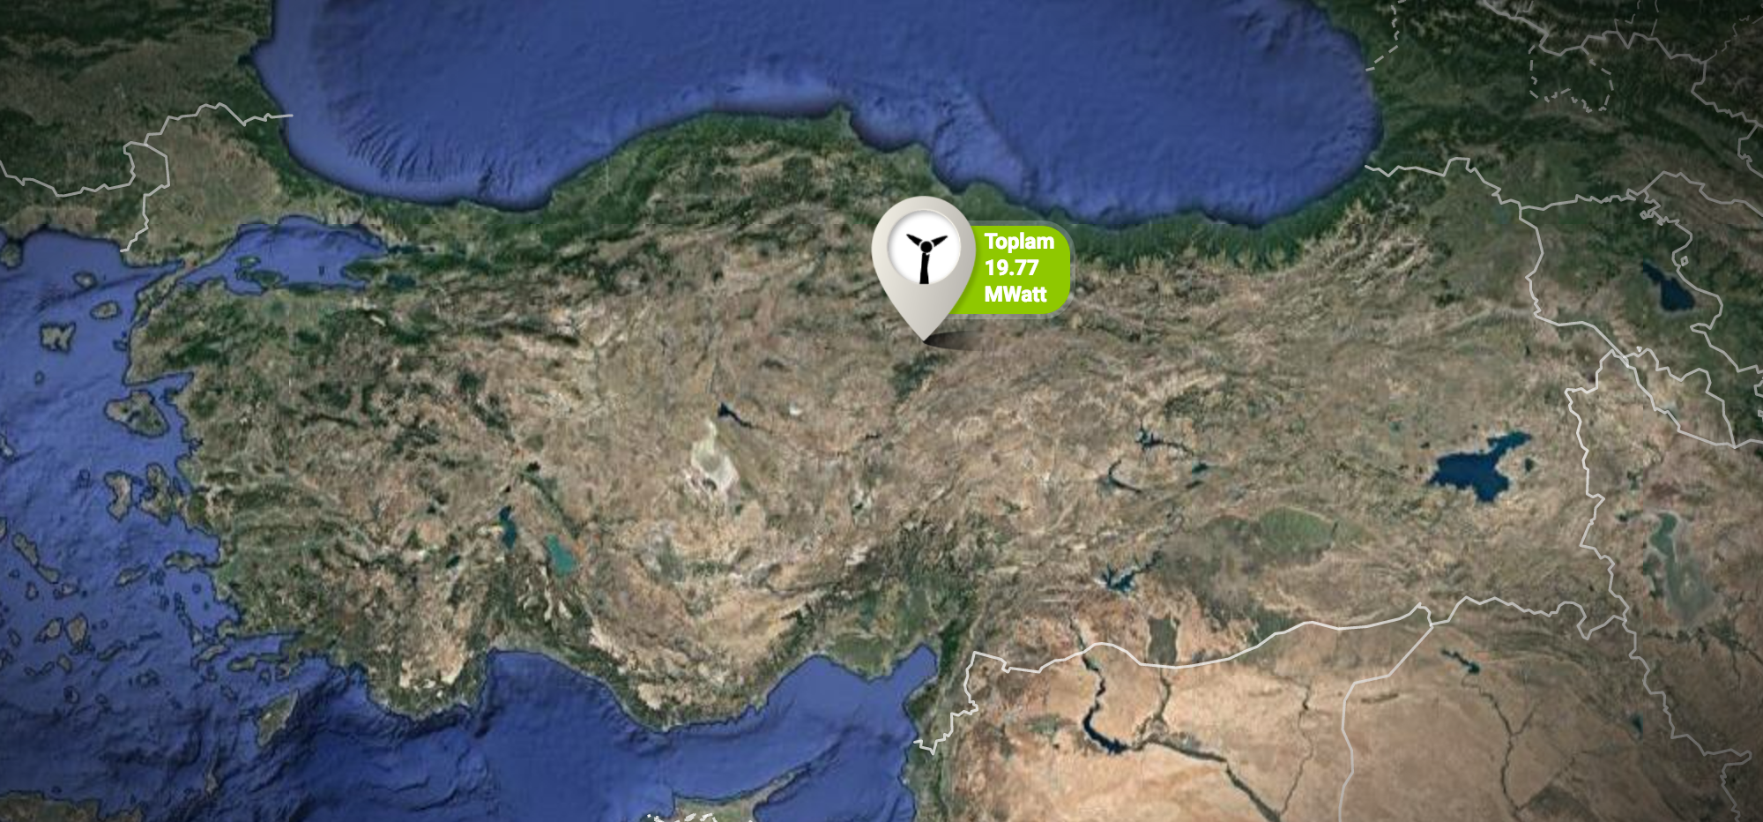
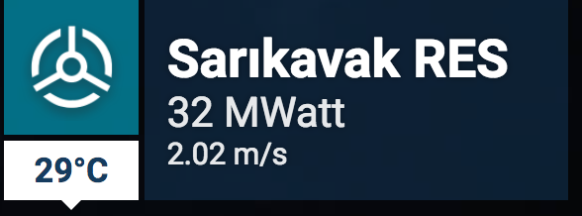



We have two power plants.
First power plants datas are ready. Second power plant has
only one data. It has not any
detail data.
SARIKAVAK RES = AIRRES RES
KONYA JES= DENİZLİ TES
AIRRES has detail datas.
It does not have click
action.

Slide 3
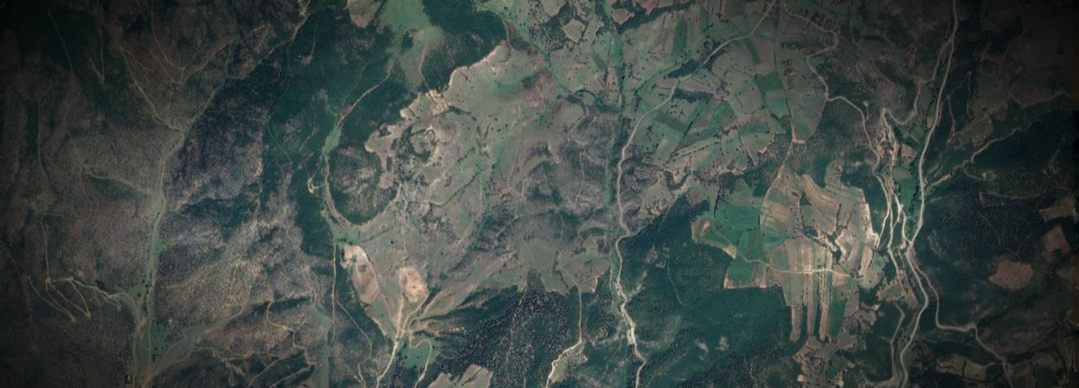
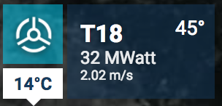
We have the 19 wind turbines.
You see the T18. It will change.
T1,T2,T3,T3,….,T19
I will give you all wind turbines
Location.
S1
S2
S3

Slide 4
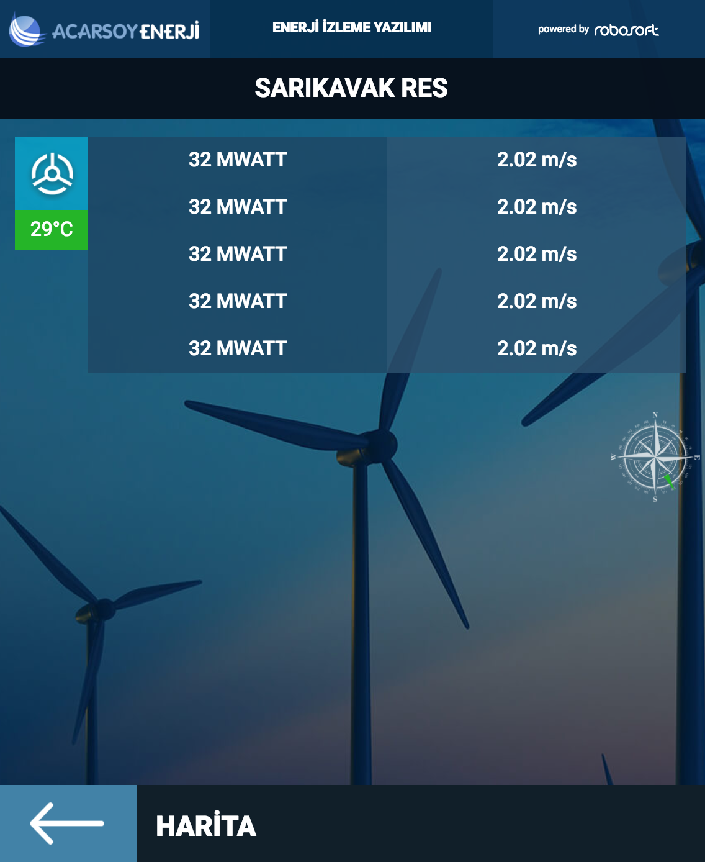
S1
There is one wind turbine detail page. When the user click the one wind
Turbine the data is coming.
T1
The data is coming like current project.
Every turbine has data table in SQL.
This is wind direction of wind turbine. It has in the table.

Slide 5
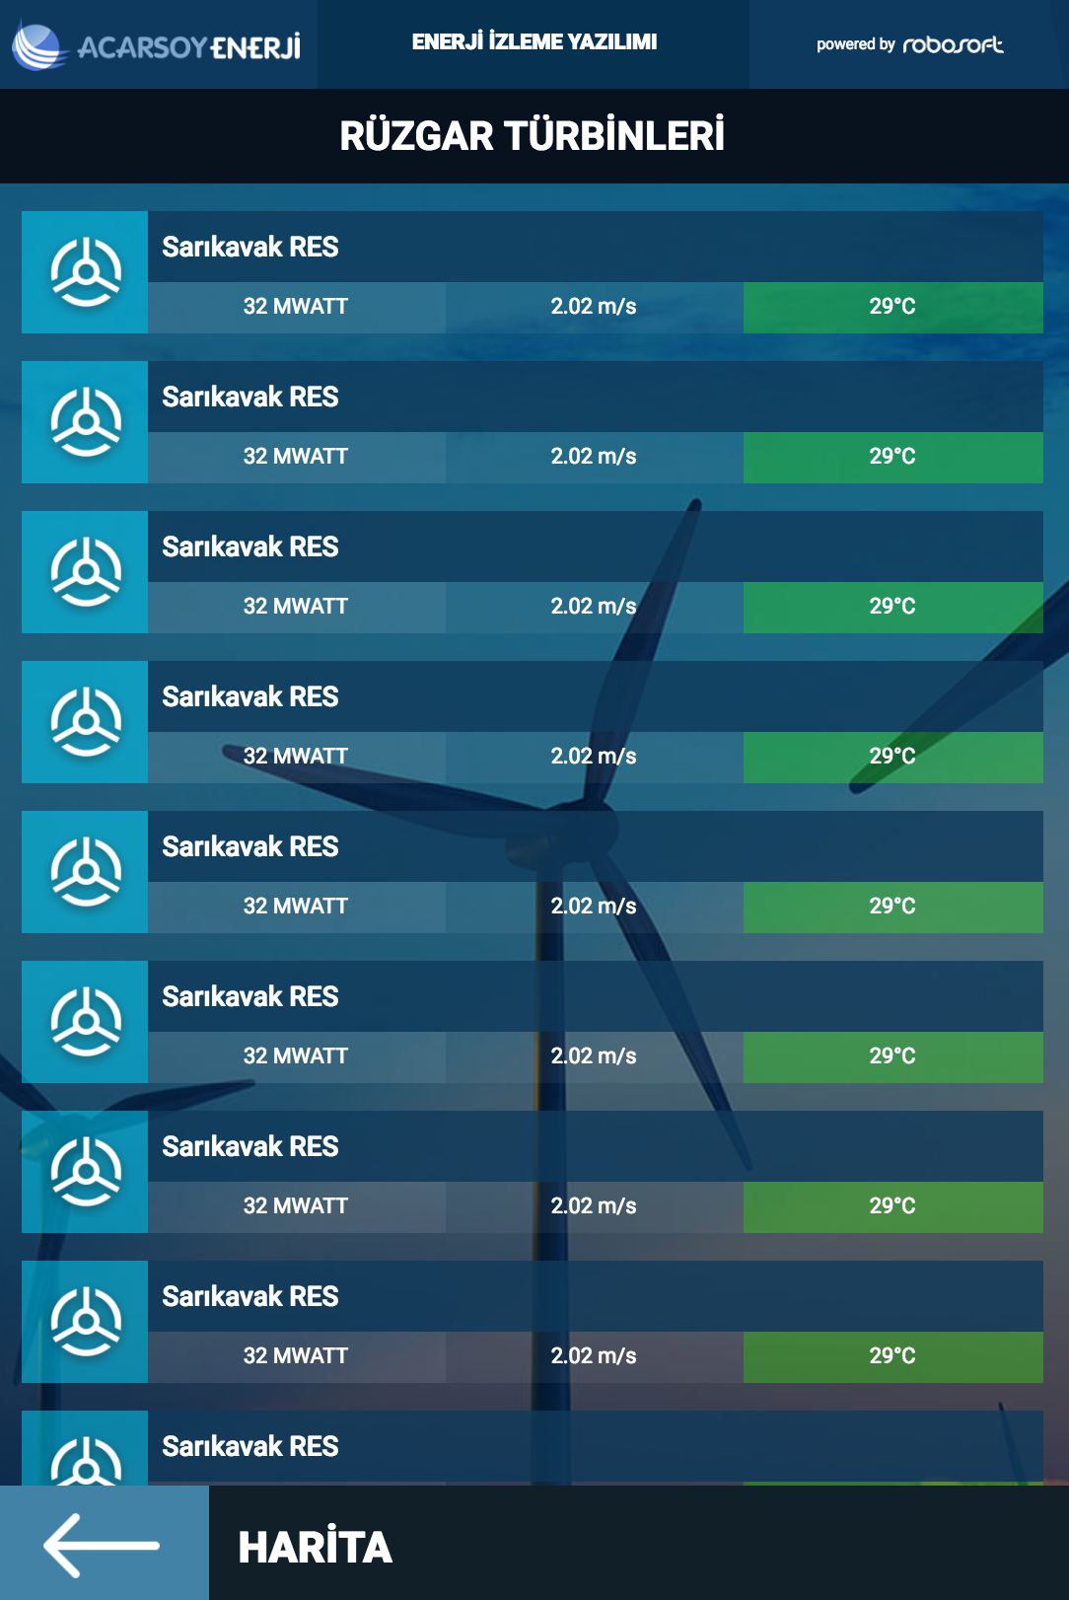
S2
This page like list view.
The turbines does not show on the map, it shows on the list.
We have 19 turbines.
T1
T2
T3
T4
T5
T6
T7
T8

Slide 6
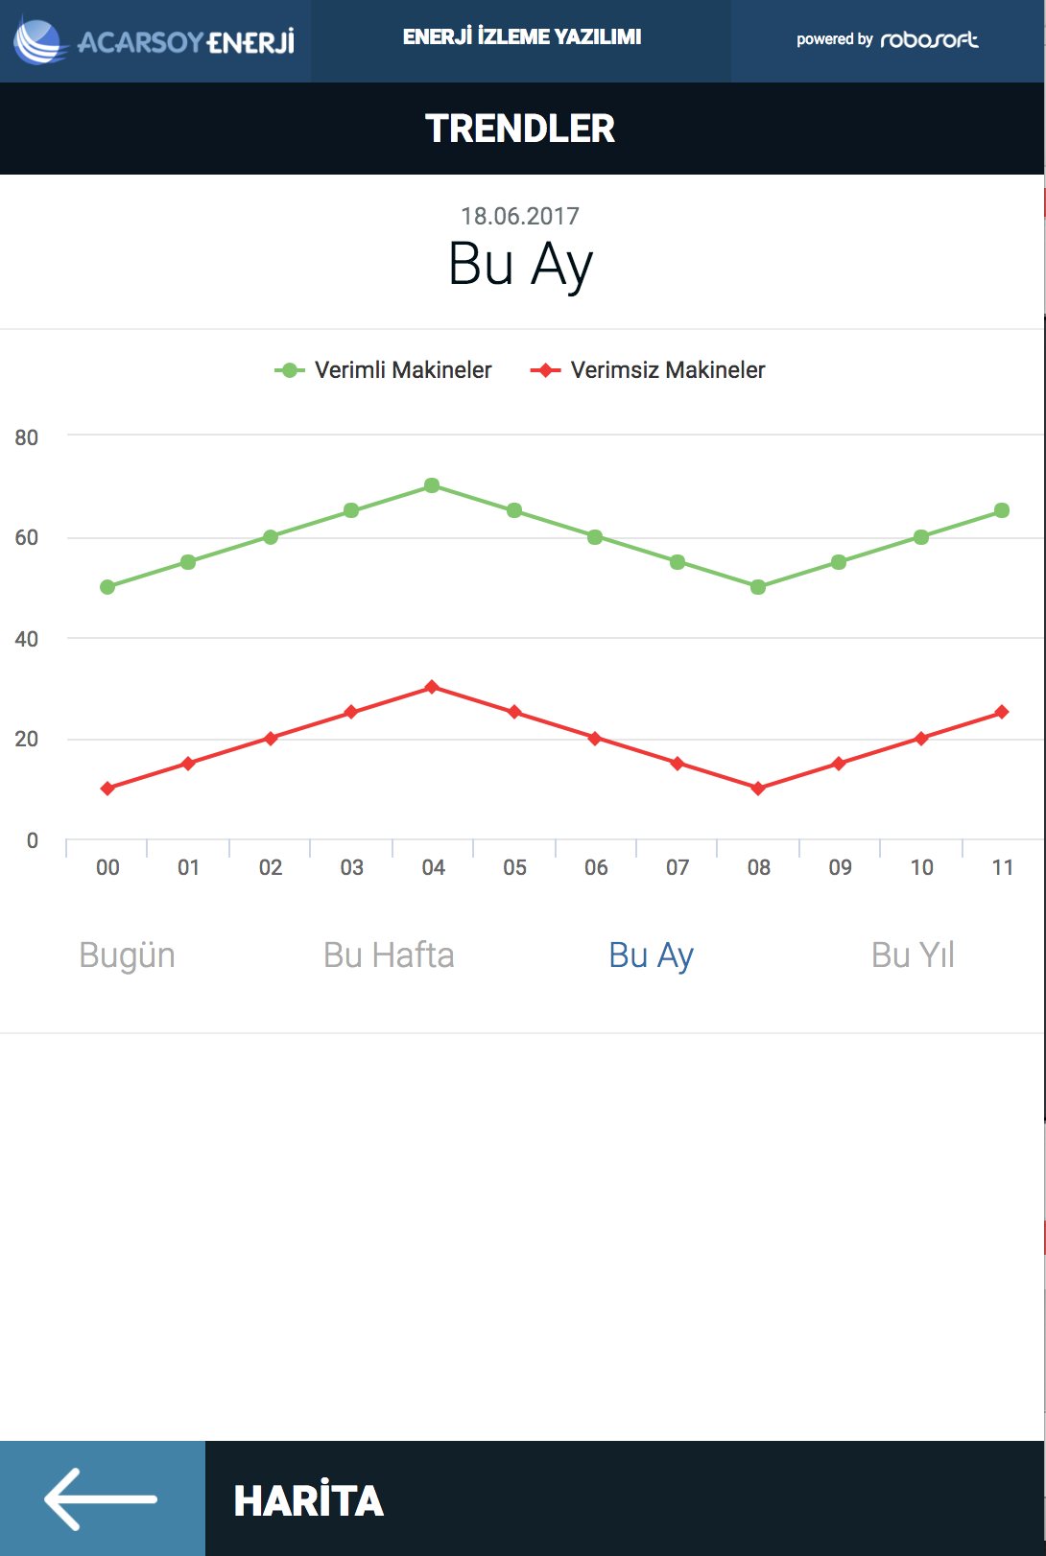
S3
I will explain this page later. Your trend view is not suitable for me.
We have professional customer. I want the same design.

